Slide 1
Go-to-Market Capacity Planning Application
Functional Overview
Application Version 1.1.0
Last Updated May 2025

Slide 2
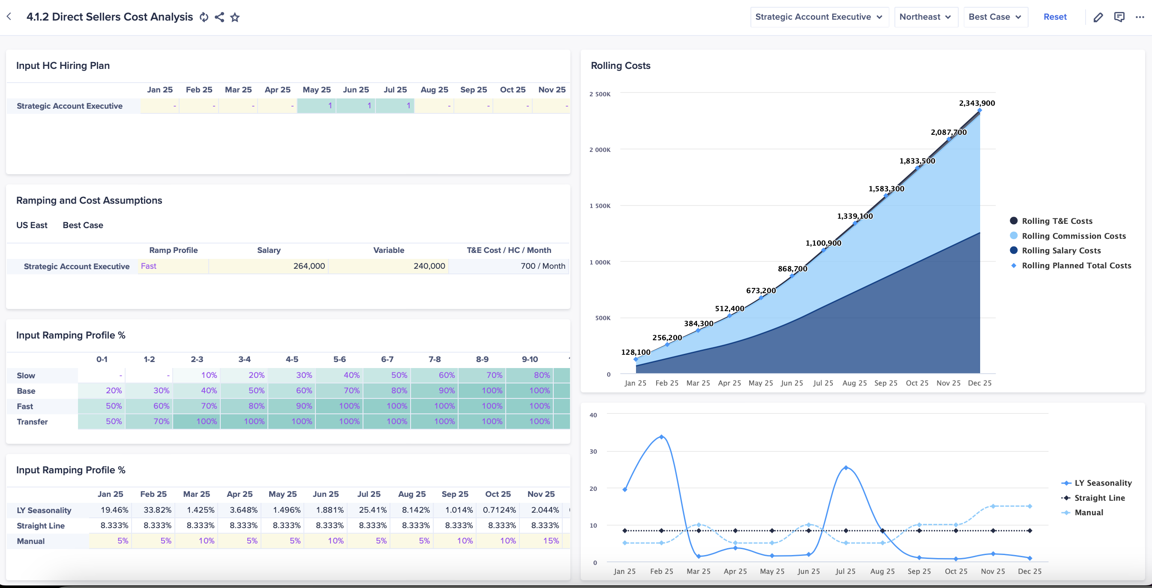
GTM Capacity Planning Application
OVERVIEW
Anaplan's GTM Capacity Planning Application helps organizations assess and optimize their go-to-market teams’ capacity to meet demand, improve sales margins, and align with sales goals and market opportunities.
KEY CAPABILITIES
Conduct a coverage analysis to identify gaps and optimize FTE reporting and headcount allocation.
Leverage sales effectiveness and ramp analysis to refine planning.
Incorporate attrition assumption data to anticipate turnover.
Apply scenario modeling and track actuals to adjust plans with cross-department input.
Perform a cost analysis to align headcount with the budget.
Use new hire impact analysis to enhance team effectiveness.

Slide 3


Anaplan Go-to-Market Capacity Planning Application
Out-of-the-box
Current FTE Reporting
Access HC data and run “what if” scenarios for workforce planning
Role-Based Reviews
Gain insights to enhance role effectiveness and performance
Key Benefits:
Optimize FTE and HC allocation for maximum efficiency.
Enhance planning with insights into sales and ramp trends.
Predict and mitigate turnover by forecasting attrition.
Enable real-time scenario modeling and performance tracking.
Align headcount with budgets to maintain cost control.
Monitoring new hire success through impact analysis.
Baseline Productivity
Access productivity to refine targets to allocations
Coverage Analysis
Adjust HC and sales coverage
HC Gap Analysis
Align headcount needs with revenue and financial goals
Top-Down Planning
Set HC targets, simulate scenarios, and optimize allocation
Bottom-Up Planning
Track hiring, attrition, and productivity trends to adapt plans
Sales Margins Planning
Model role-specific costs and sales margins to boost profitability
In-Year vs Actual Plan
Lock plans, compare snapshots, and optimize coverage

Slide 4








Anaplan GTM Capacity Planning Application
Out-of-the-box
Current FTE Reporting
Access HC data and run “what if” scenarios for workforce planning.
Key Benefits:
Optimize FTE and HC allocation for maximum efficiency.
Enhance planning with insights into sales and ramp trends.
Predict and mitigate turnover by forecasting attrition.
Enable real-time scenario modeling and performance tracking.
Align headcount with budgets to maintain cost control.
Monitoring new hire success through impact analysis.
In-Year vs Actual Plan
Lock plans, compare snapshots, and optimize coverage.
Role-Based Reviews
Gain insights to enhance role effectiveness and performance.
Sales Margins Planning
Model role-specific costs and sales margins to boost profitability.
Baseline Productivity
Access productivity to refine targets to allocations.
Coverage Analysis
Adjust HC and sales coverage in real time to close gaps.
Bottom-Up Planning
Track hiring, attrition, and productivity trends to adapt plans.
HC Gap Analysis
Align headcount needs with revenue and financial goals.
Top-Down Planning
Set HC targets, simulate scenarios, and optimize allocation.
Sales Margins Planning
Model role-specific costs and sales margins to boost profitability.
In-Year vs Actual Plan
Lock plans, compare snapshots, and optimize coverage.
Notes:
The Anaplan GTM Capacity Planning Application includes the following components:
HC Gap Analysis: Evaluate HC needs based on account volume, revenue targets, and historical data while aligning with financial goals
Top-Down Planning: Distribute HC targets, simulate scenarios, and optimize allocation and approvals.
Bottom-Up Planning: Track trends in hiring, attrition, and productivity and run scenarios to adapt plans.
Sales Margins Planning: Capture role-specific cost data and model dynamic sales margins to improve profitability.
In-Year vs Actual Plan: Lock plans for data integrity, adjust, and compare snapshots to optimize coverage.
Baseline Productivity: Evaluate productivity vs. quota attainment to optimize targets and resource allocation.
Coverage Analysis: Balance HC allocation while adjusting sales coverage in real time to address gaps.
Role-Based Reviews: Analyze performance to gain actionable insights for improving role effectiveness.
Current FTE Reporting: Access HC and FTE data and simulate "what-if" scenarios with employee-level insights.
As a customer, this applications empowers you with sped and agility to quickly:
Optimize FTE and HC allocation for maximum efficiency.
Enhance planning with insights into sales and ramp trends.
Predict and mitigate turnover by forecasting attrition.
Enable real-time scenario modeling and performance tracking.
Align headcount with budgets to maintain cost control.
Monitoring new hire success through impact analysis.

Slide 5
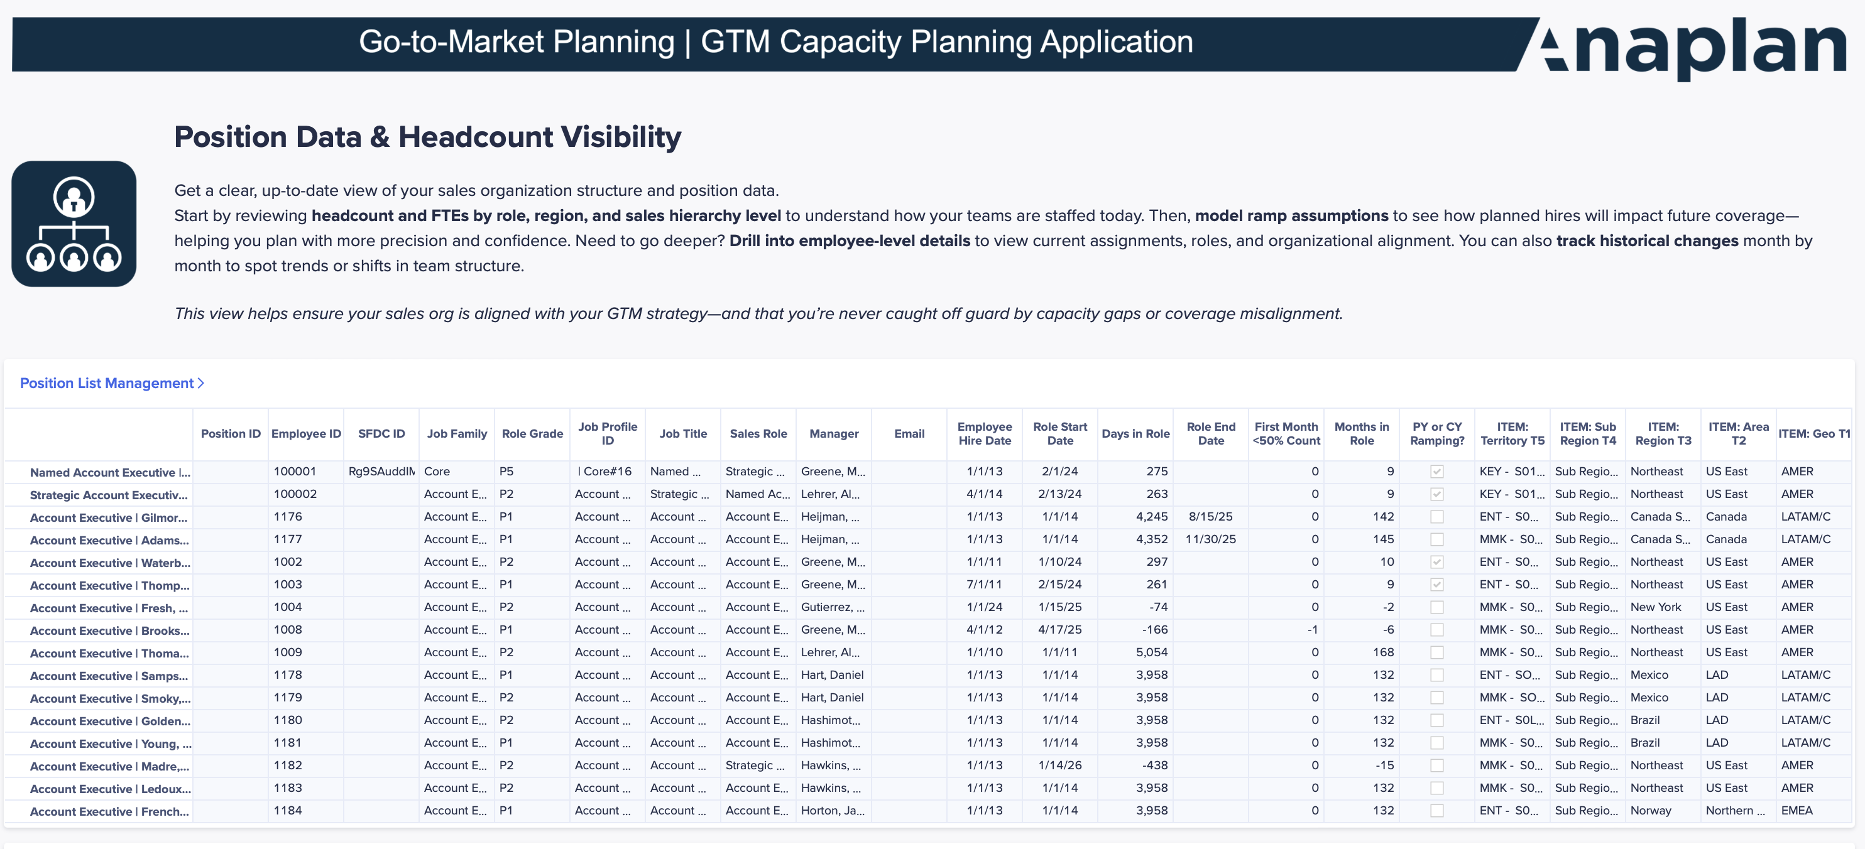
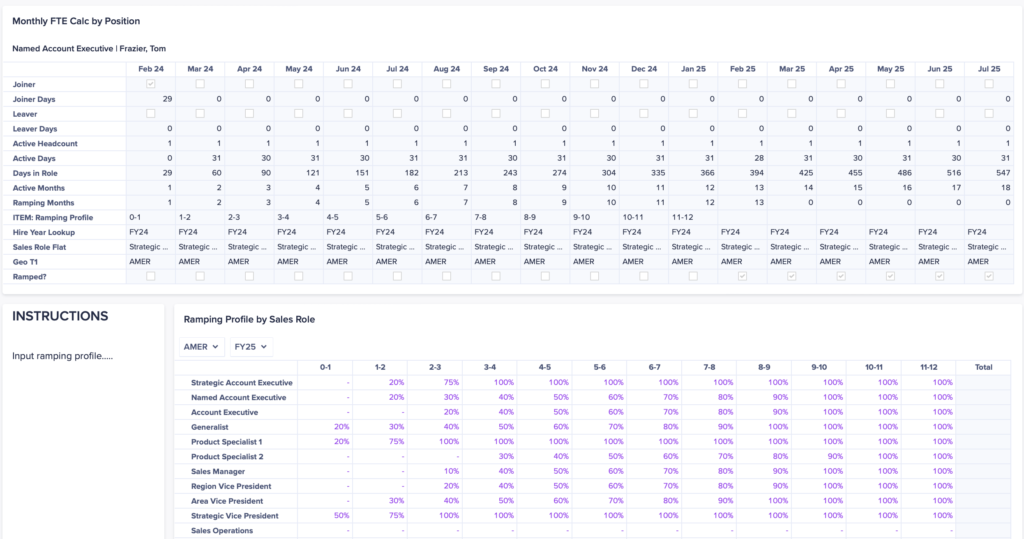
GTM Capacity Planning Application
Headcount & FTE Reporting
Real-time visibility into HC by sales hierarchy level
Report FTEs by role, region, and month
Model ramp assumptions to project future coverage
Drill into employee-level details by role and org
Track historical role assignments month by month

Slide 6
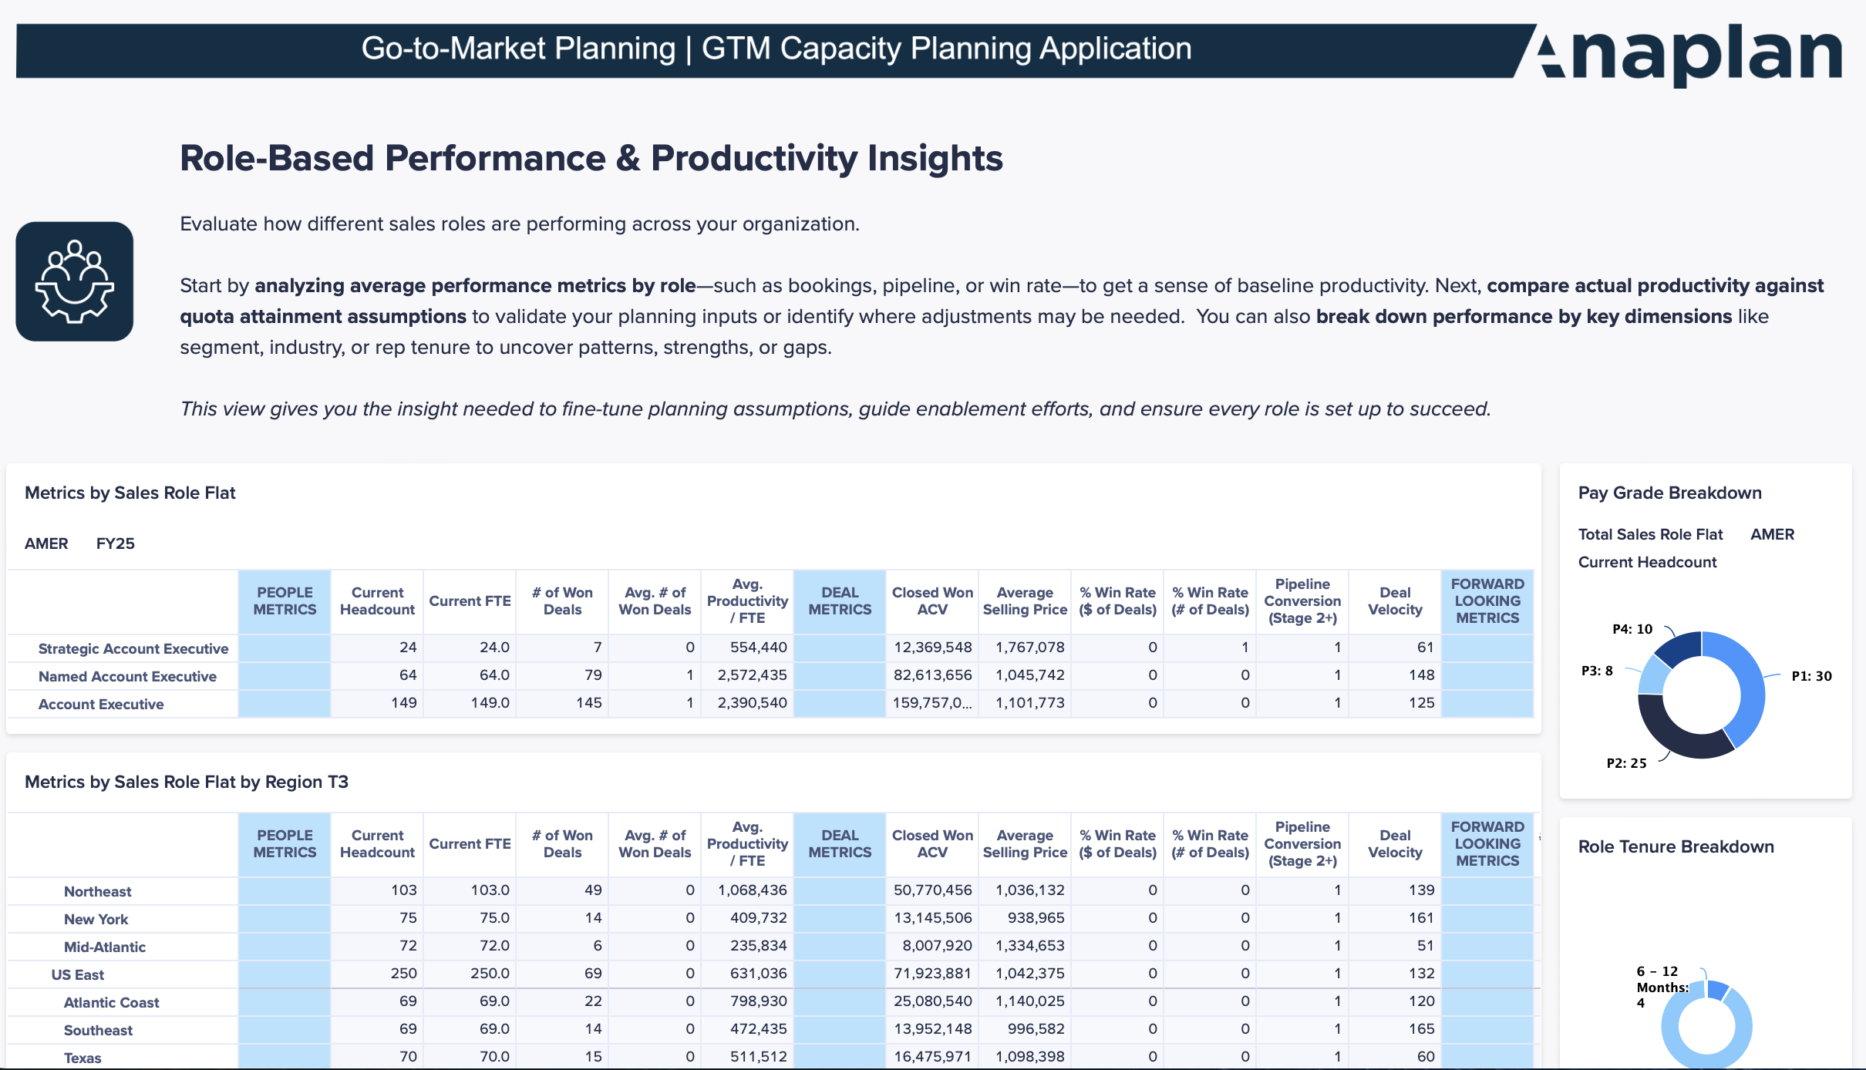
GTM Capacity Planning Application
Role-Based Performance & Productivity
Analyze average performance metrics by role across your org
Evaluate productivity uplift
Break down role performance by segment, industry, tenure, and more

Slide 7
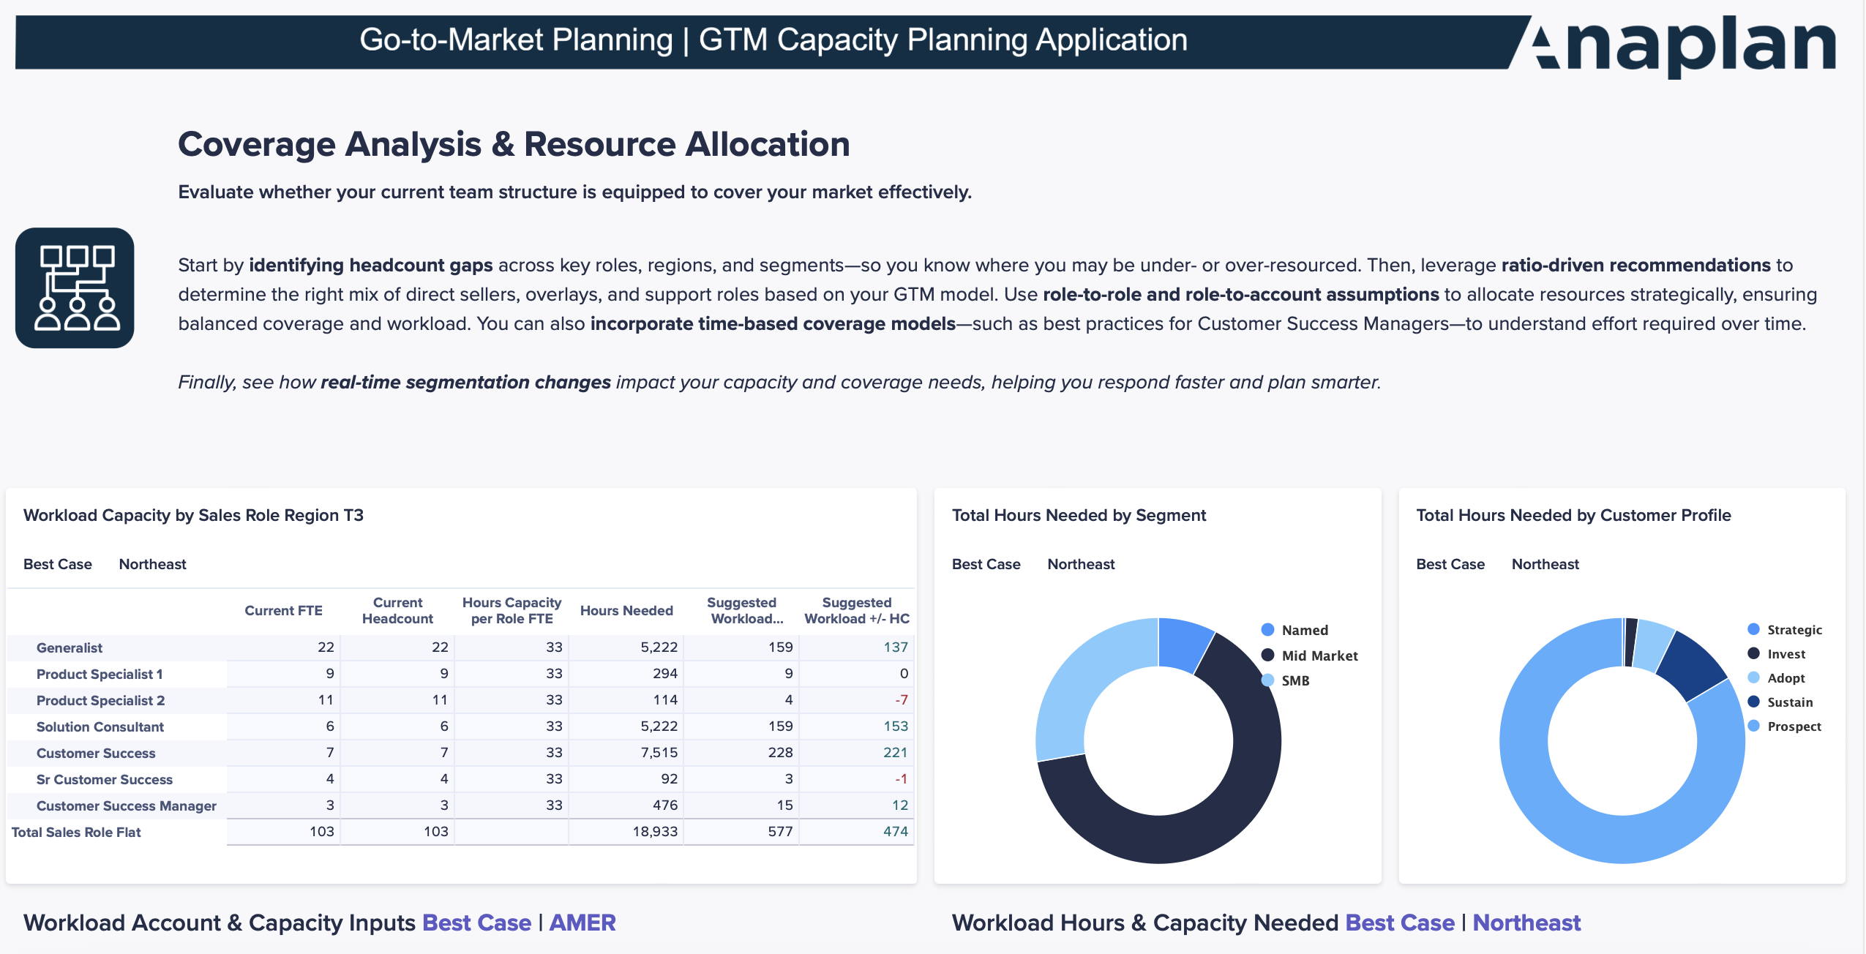
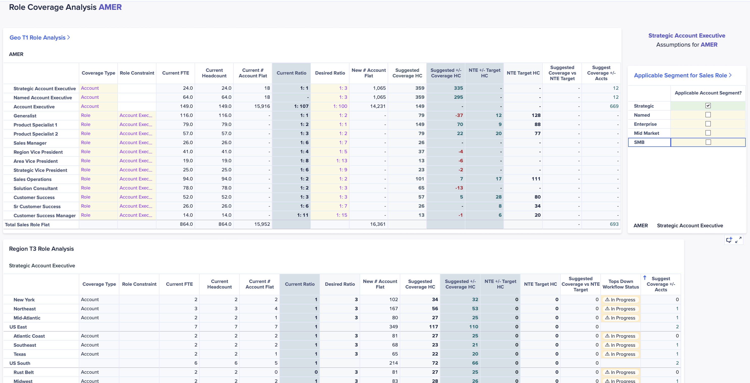
GTM Capacity Planning Application
Coverage Analysis & Resource Allocation
Identify headcount gaps across roles, regions, and segments
Use ratio driven recommendations for direct, overlay, and support role coverage
Allocate resources with role-to-role and role-to-account assumptions
Incorporate time-based coverage models (e.g., CSM best practices)
See real-time segmentation impact on capacity and coverage gaps

Slide 8
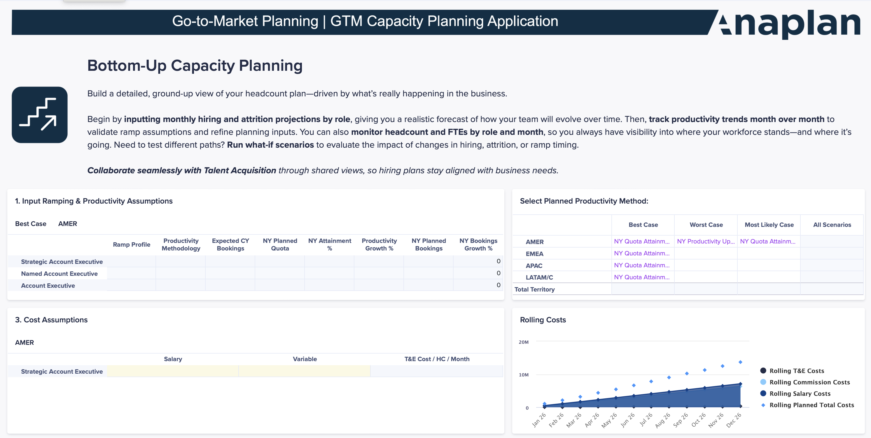
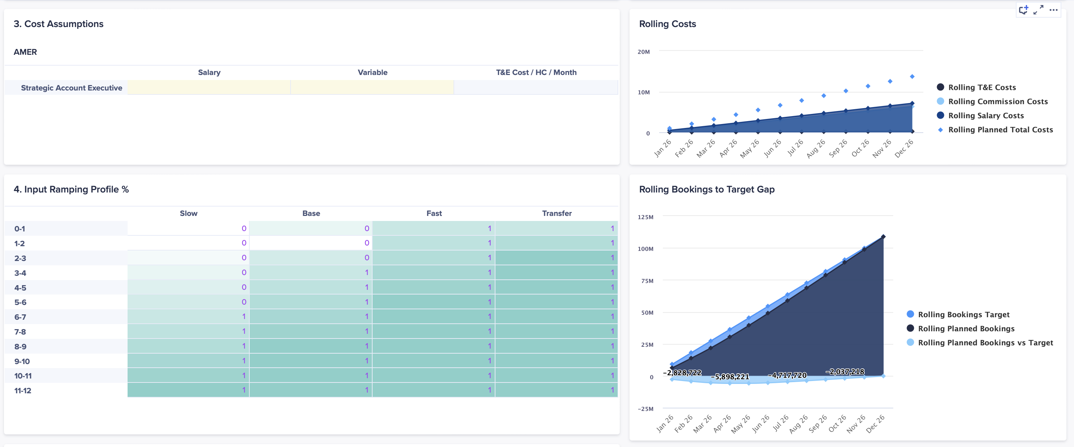
GTM Capacity Planning Application
Bottom-Up Planning
Input hiring and attrition monthly by role for accurate projections
Track productivity trends month over month
View HC & FTE by role and month for workforce visibility
Run what-if scenarios to test different planning assumptions

Slide 9
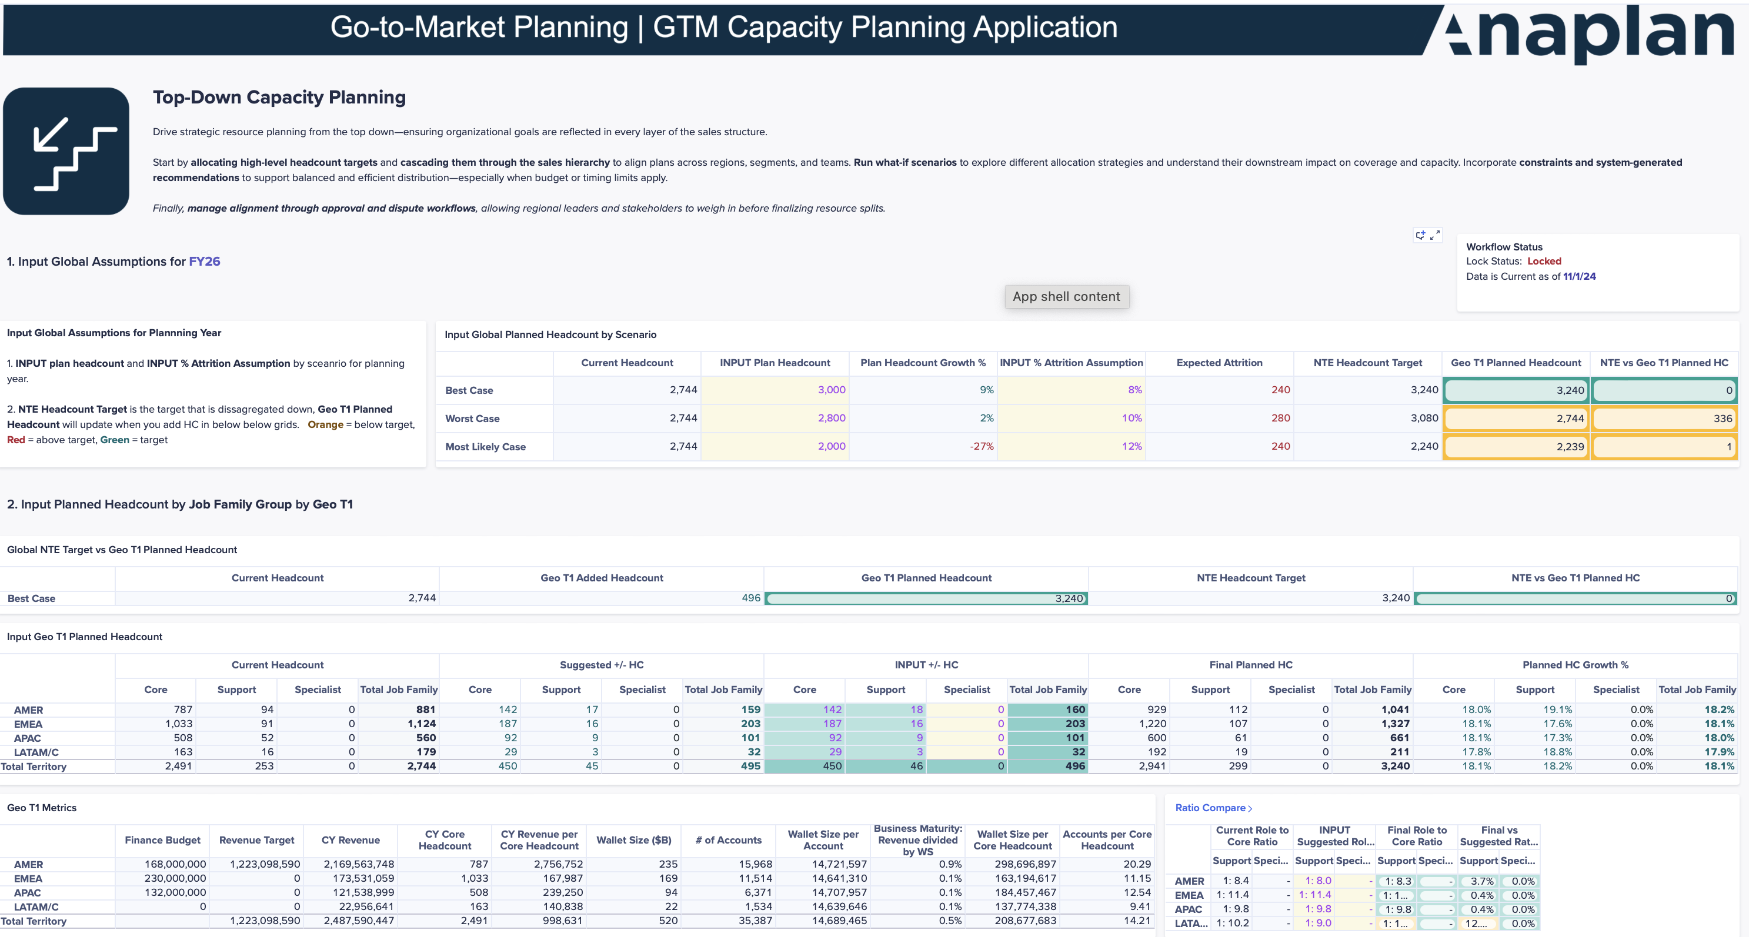
GTM Capacity Planning Application
Top-Down Planning
Allocate headcount targets and cascade by sales hierarchy
Run what-if scenarios to test allocation strategies
Apply constraints and system-generated recommendations
Enable approval and dispute workflows for resource splits

Slide 10
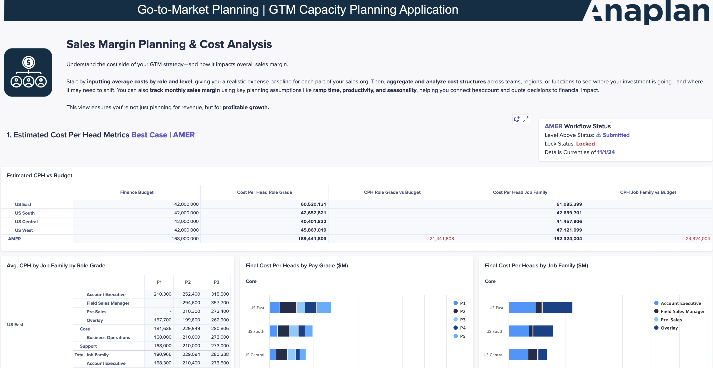
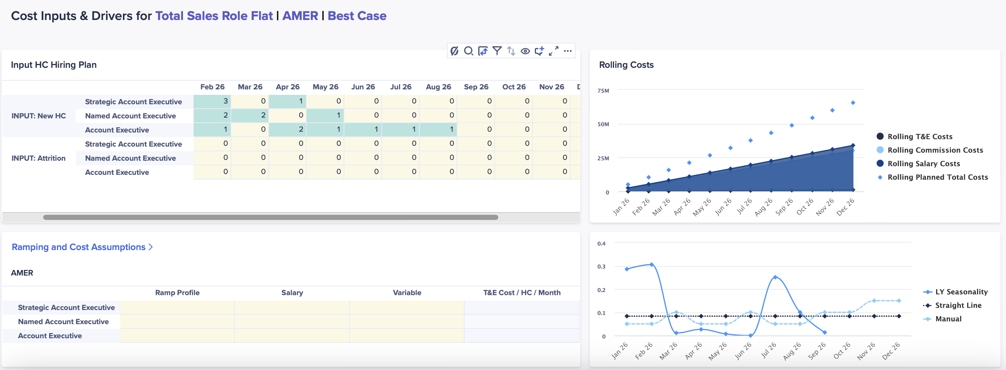
GTM Capacity Planning Application
Sales Margin Planning & Cost Analysis
Input average cost by role and level to model expenses
Aggregate and analyze cost structure across teams
Track monthly sales margin using ramp, productivity, and seasonality assumptions

Slide 11
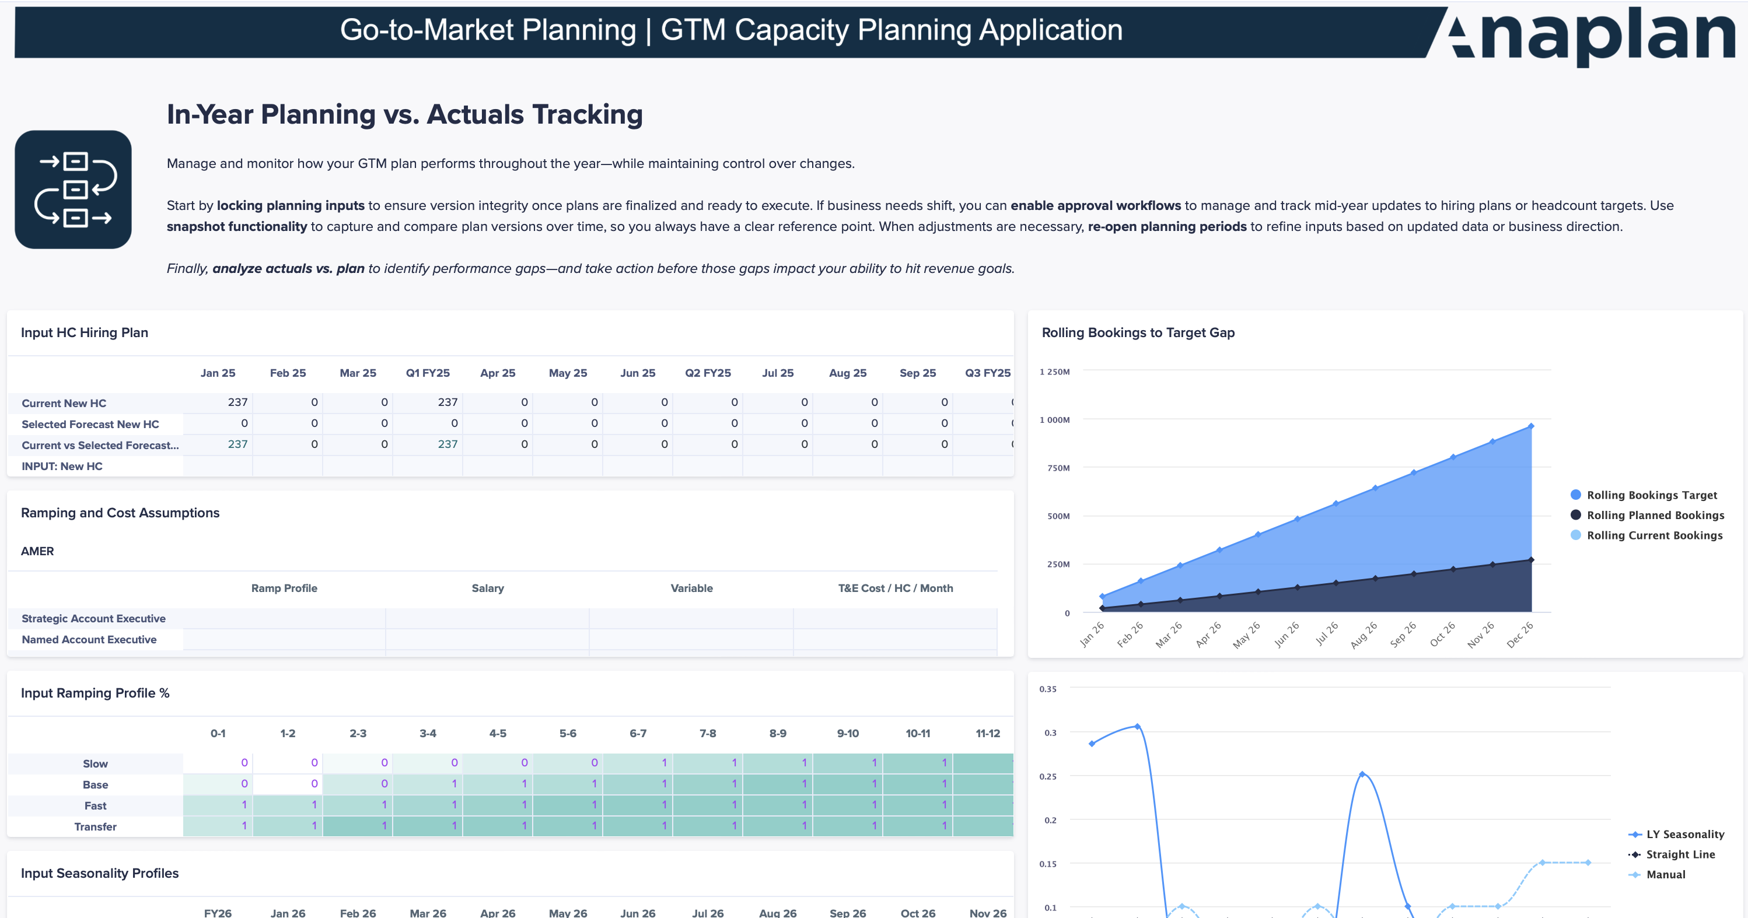
GTM Capacity Planning Application
In-Year Planning vs. Actuals Tracking
Lock planning inputs to preserve version integrity
Enable approval workflows for mid-year changes
Snapshot hiring plan versions for comparison
Re-open planning periods when adjustments are needed
Analyze actuals vs. plan to understand performance gaps

Slide 12

Anaplan Go-to-Market Capacity Planning Application – Summary
DETAILED FUNCTIONALITY VIEW IS INTERNAL & PARTNER ONLY – DO NOT SHARE WITH PROSPECTS
FTE & Headcount Reporting
Sales Margin Planning
  Track FTE and headcount with real-time visibility by role, hierarchy, and month across the GTM hierarchies
  View employee-level details, role history, and model ramp assumptions
  Define role-based cost structures and aggregate data
  Track monthly sales margins based on productivity and ramping
Coverage Analysis
In-Year vs. Actual Planning
Go-to-Market Capacity Planning
  Identify HC gaps and optimize core vs. support resources
  Define role-based and time-based coverage assumptions
  Lock planning inputs and snapshot hiring plans
  Compare actual vs. planned HC and hiring needs for realignment; re-open planning period to adjust strategy
Top-down & Bottom-up Planning
  Input hiring, attrition, and productivity assumptions per role
  Track monthly headcount trends and hiring needs
  Cascade resource allocation through the sales hierarchy
  Apply constraints and recommendations for resource planning
  Manage approvals and disputes in a structured workflow
Productivity & Performance Analysis
  GTM Strategy & Blueprinting
  Model sales hierarchy changes in a sandbox.
  Maintain an approval workflow and audit trail
  Conduct what-if scenario modeling for strategic decisions
  Approve and export finalized headcount plans
  Analyze and compare reps against role-based performance by configurable dimensions (e.g., segment, industry, tenure)
  Model productivity uplift

